Slide 1
Learning Safari Writing Independently
Crystal Loose and Nathan Eakin

Slide 2
What the Research Says
Written language includes recognition of visual, spatial directional properties, and organizational formats (McGee & Richgels, 2008).
Equipped with the necessary knowledge, parents can help encourage their child through the writing developmental stages from scribbling and drawing to phonetic, transitional, and conventional writing (Reutzel & Cooter, (2012).
The reciprocal nature between reading and writing has shown that it is paramount that these two skills must be taught collectively (Cordova & Matthiesen, 2010; Shanahan, 2006; Reutzel & Cooter, 1990).

Slide 3
The Beginning

Slide 8
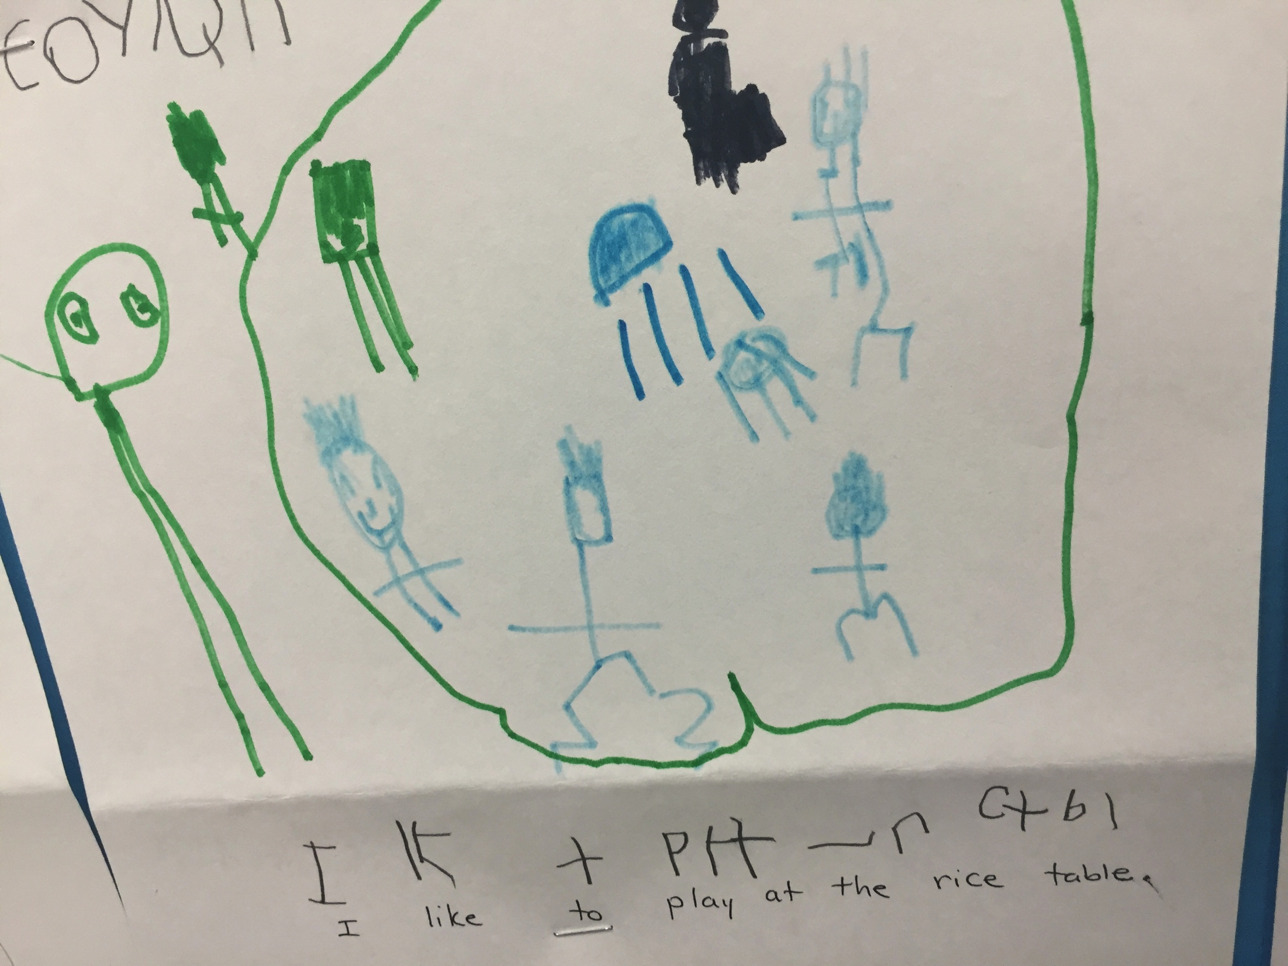

Slide 9
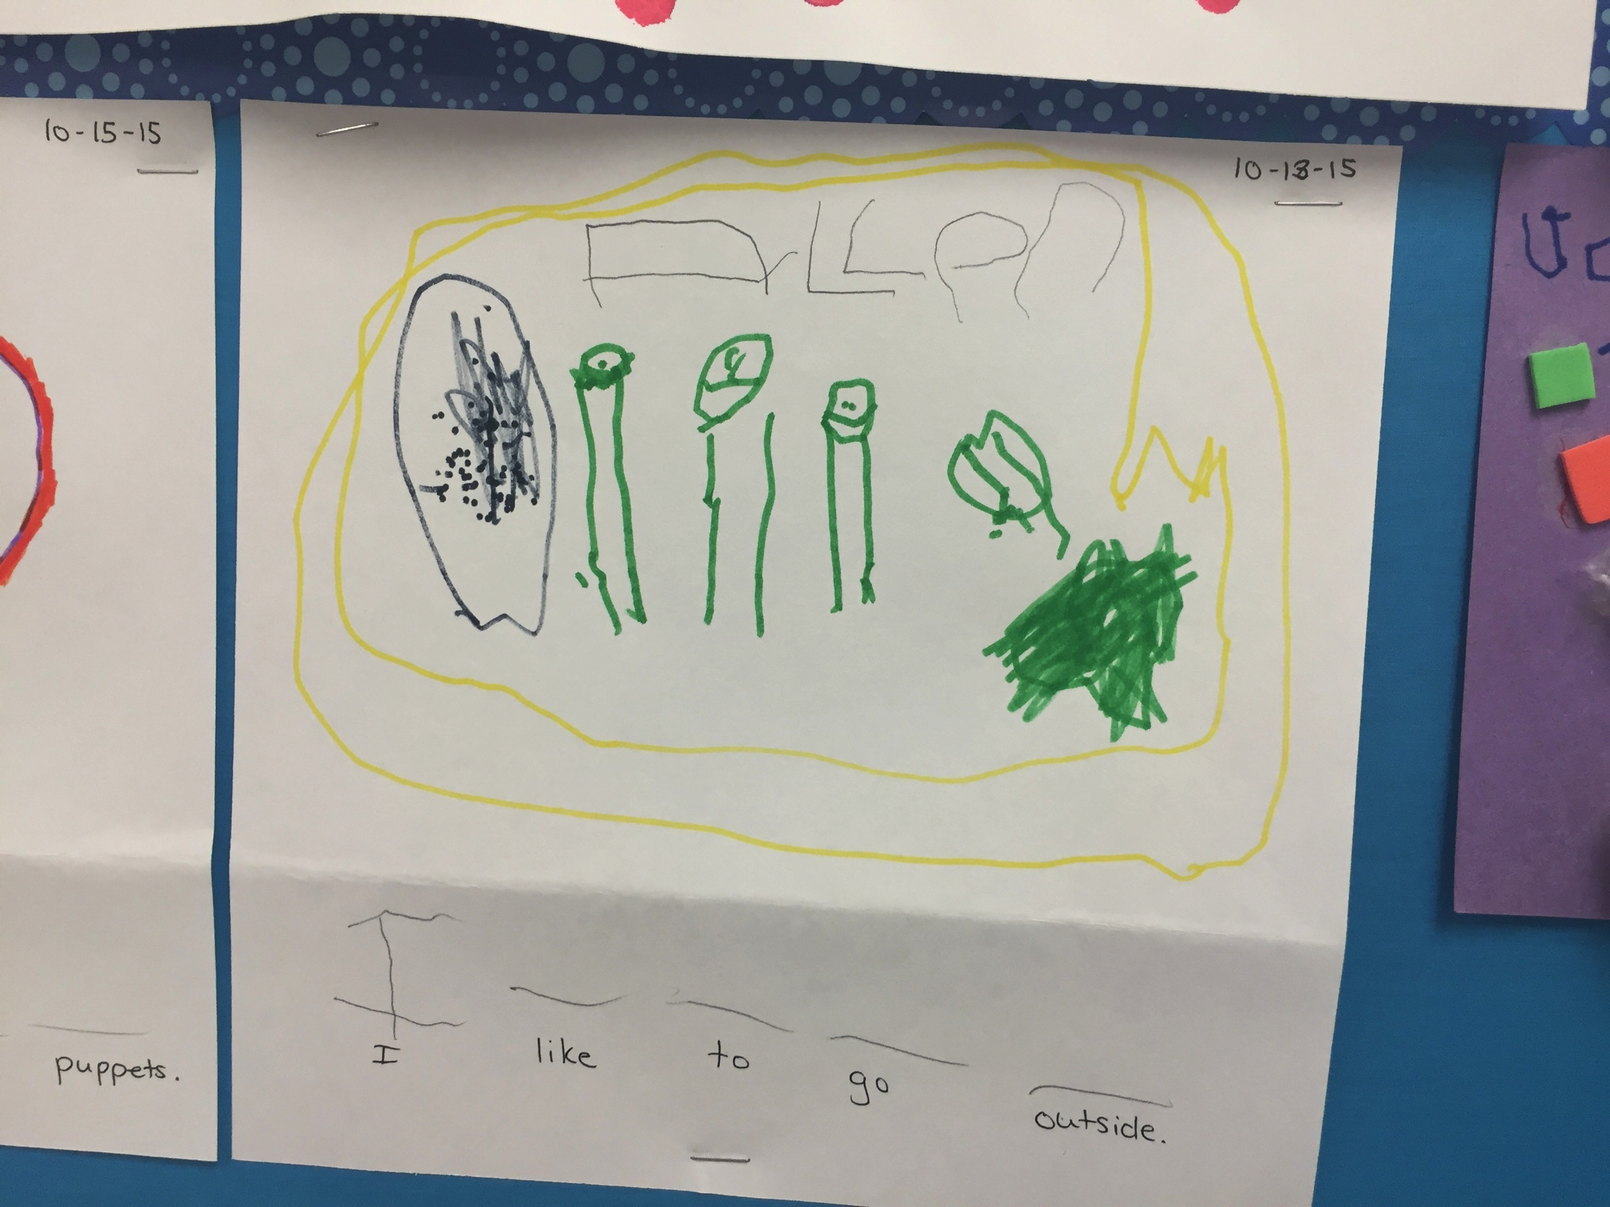

Slide 10
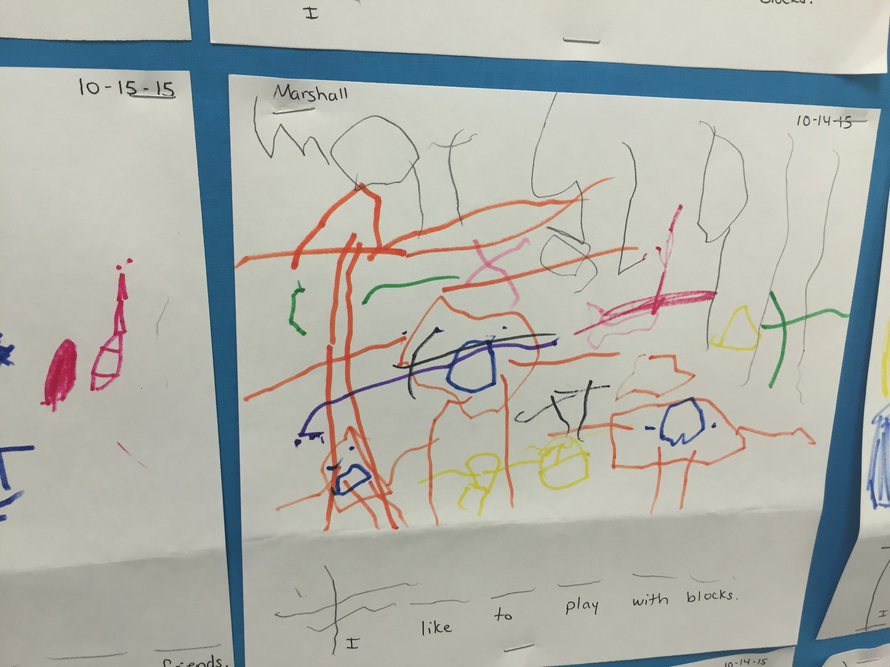

Slide 11
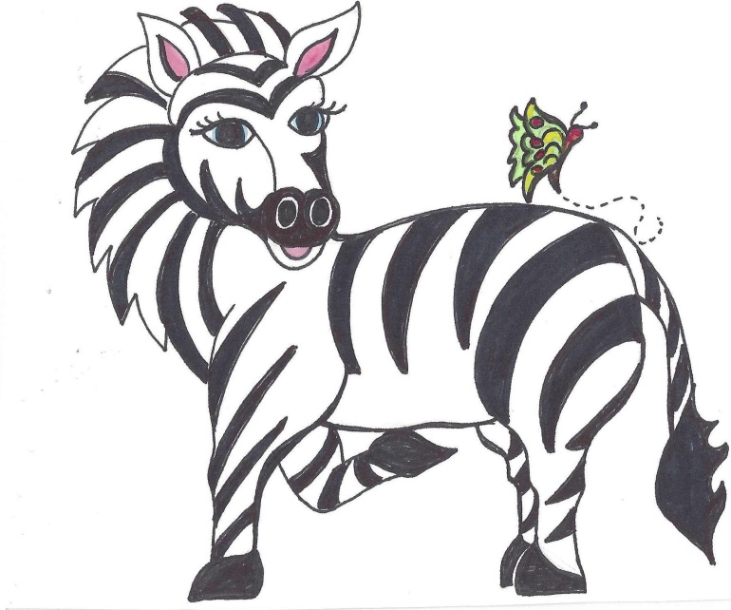
Writing Independently Agenda
Interactive Writing Lesson
Elkonin Segmentation Boxes
What’s Inside the Envelope?
Writing Games
Writing Journals
Program Evaluation

Slide 12
Interactive Writing
Interactive Writing involves the sharing of a pen to compose a story jointly.
Using chart paper, create a single sentence writing composition together.
Pause to allow students to write beginning sounds and sight words.
Create a picture that matches the sentence. Talk about how pictures show what the story words are telling us.

Slide 13
Elkonin Boxes
at | sat | sit | mop | map | tap
run | sun | bun | in | pin | rat
cup | cap | cat | red | pot | tin

Slide 14
What’s Inside the Envelope?
Topic Frames: Cut, sort, and classify the Theme Photos. Choose a group of four to work with. Have your child write a label for each of the four boxes. Together orally, create a story about the four pictures. Choose one of the boxes to use for a complete story. Write more than one sentence about this box in your writing journal.
Topic Photos: Use any of the pictures from the Informational Photo Gallery and have your child write what this picture makes them think of. Try to write three sentences together. You can use interactive writing for the entire process.

Slide 15
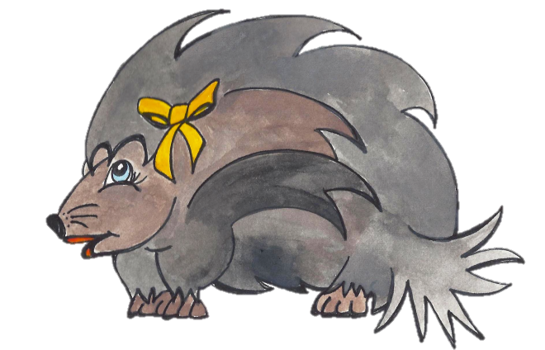
Writing Games
Patty’s Picture Frames: Place the picture in the middle that has the matching beginning and ending letters.
Safari Sounds: Choose a picture from Patty’s Pictures and then write the beginning and ending sound for that picture.

Slide 16
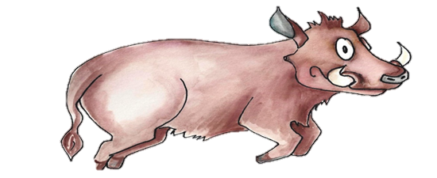
Please complete your program evaluation. Thank you for your participation on the Learning Safari!

