Slide 1
Safari Learning Rhyming and Vocabulary
Crystal Loose and Nathan Eakin

Slide 2
What the Research Says
Preschoolers who are provided phonemic awareness training will learn how to properly sequence sounds within a word and later grasp an understanding of onset and rime.
Once this understanding is efficient and a firm grasp of rime is understood, students will then be ready to rhyme. Rime involves the vowel and final consonants of the word, such as the /at/ in cat.
A pre-readers knowledge of letters and their names is important, but not enough. Familiarity with letters, combined with exposure and practice of phonetic structure, is essential for reading success (Otaiba et al., 2008).
Connections between oral language and print must be thoroughly developed to achieve reading success (Snow et al, 2007).
Parents must be their child’s first teacher by helping children discover words in picture books and developing oral vocabulary through interactive discussions (Cunningham, Perry, & Stanovich, 2001).

Slide 3
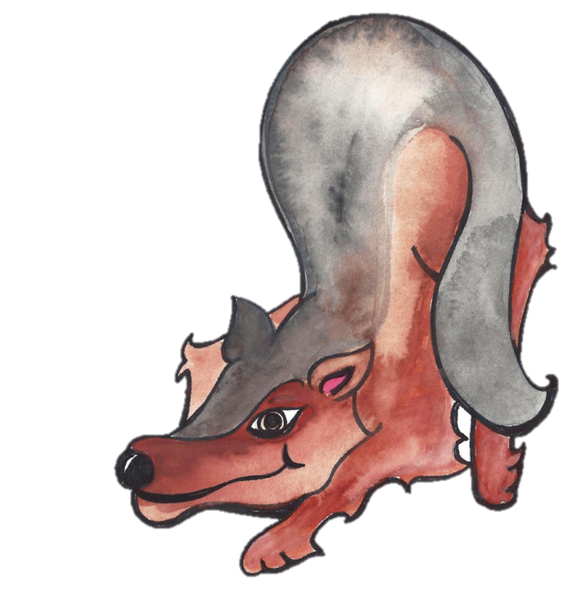
Rhyming and Vocabulary Agenda
Rhyming and Vocabulary: Why is it essential
Vocabulary Enrichment Strategies
Poetry Books
Rhyming Games
Car Games

Slide 4
Why Do Students Need Rhyme and Vocabulary?
The rhyme level of phonemic awareness is essential for early reading success.
Rhyme is essential for successful decoding. (reading)
Rhyme is vital for successful encoding. (spelling)
Vocabulary is essential to reading and reading comprehension.
Oral language experiences enhance overall word meanings learned.
Listening to adults read is another indirect way children acquire vocabulary.
It is effective when adults stop and elaborate on new or interesting words, discussing meaning in the context of the story.
Teaching children vocabulary strategies before they can read, will help them as they read independently and encounter unfamiliar words.

Slide 5
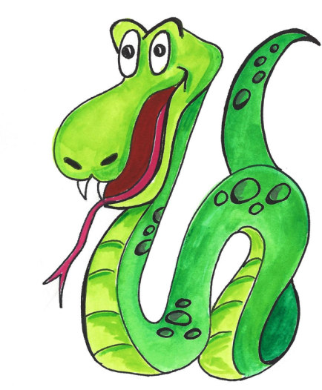
Vocabulary Enrichment Strategies
Building vocabulary through introductions
Pinkalicious by Victoria and Elizabeth Kann
Extending vocabulary through description
The Important Book by M.W. Brown
Enriching vocabulary with synonyms
Fancy Nancy by Jane O’Connor
Encouraging rhyme with books
Mrs. Brown Went to Town by Wong Herbert Yee

Slide 6
Vocabulary Enrichment Read-Aloud
Vocabulary introductions before reading:
“I gobbled up a couple of cupcakes while Mommy and I frosted them.”
What do you think she did when she gobbled up the cupcakes?
“I put on my pink fairy princess dress and twirled in front of the mirror.”
Show me how she moved.
“She didn’t see me because I blended in with the pink peonies.”
How do animals blend in with things in nature?
“He was green with envy.”
When you envy someone you wish you were like them or had what they had. Did you ever envy someone? Why?
Excerpts quoted from:
Pinkalicious by Victoria and Elizabeth Kann

Slide 7
Vocabulary Enrichment Read-Alouds
Extending vocabulary through description:
Before reading ask, “What do you think Margaret Wise Brown will say is important?
After reading begin to form lists based on information from the book as well as items that are not inside the book.
Spoon- flat, hollow, shovel
Daisy- white, yellow, ticklish
Rain- wet, sky, shiny, air
Grass- green, grow, tender, smell
Excerpts from The Important Book by Margaret Wise Brown

Slide 8
Vocabulary Enrichment Read-Aloud
Increasing vocabulary with synonyms:
Before reading think about some items that you have seen that are fancy.
During reading pause to discuss words found in the book and their synonyms. For example: stupendous, amazing, awesome, great.
After reading draw something from the book and use new words to describe it.
Vocabulary from: Fancy Nancy by Jane O’Connor

Slide 9
Vocabulary Enrichment Read-Alouds
Encouraging rhyme with books
Before reading have children attempt to rhyme with yak. Rhyming with nonsense words is encouraged.
During reading have kids listen for rhyming words and recite more words that go along with the rhyme. As you read, pause and have children attempt to complete the sentence with a word that rhymes.
After reading, write a sentence with rhyming words. Create a picture to go along with it.
Excerpts from Mrs. Brown Went to Town by Wong Herbert Yee

Slide 10
Increasing Vocabulary with Lists
When talking with your child substitute a new word for a word they stated. For example:
Child: I like ice cream
Parent: I enjoy eating ice cream too.
Possible Word Choices
Excited: eager, thrilled, impatient, enthusiastic
Favorite: choice, desire, alternative, option
Like: amusing, enjoyable, terrific, super
Surprise: shock, astonish, amazement
Tell: inform, know, explain, enlighten

Slide 11
Playing With Safari Rhymes:
Locate letters: Wikki Stix, highlight, underline, circle (great to practice following directions by varying tasks)
Highlight words that rhyme
Make lists of rhyming words and talk about the part of the word that is identical
Expand the sentence by adding more detail
Rewrite poems
Put on large poster paper
1:1 pointing (concepts of print)

Slide 12
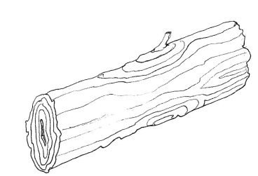
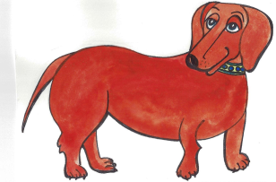
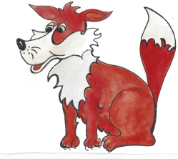
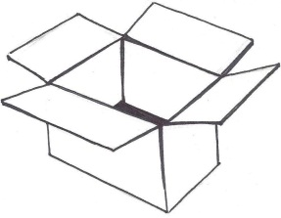
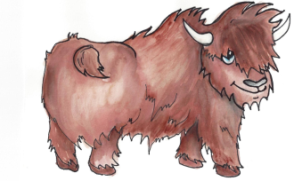
Safari Rhyme
Diego the dog is on a log.
Felix the fox is on a box.
Yoshi the Yak is on a tack.

Slide 13
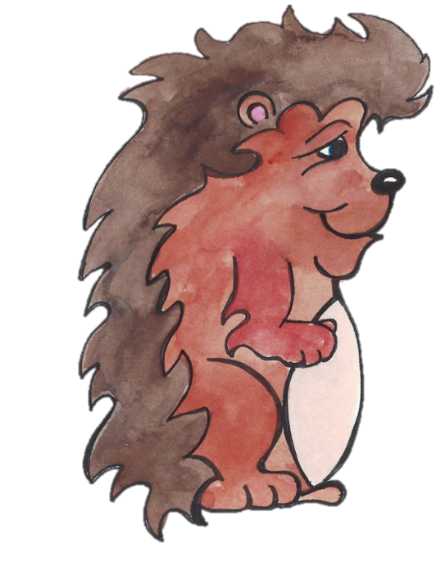
Rhyming Games
Harry’s Hut of Rhymes
Rhino Rhymo
Macy’s Match
Draw-a-Rhyme
Rhyme Concentration
Rhyme Time

Slide 14
Jeep Games
We are going on a safari….
Which doesn’t belong?
Cat, Song, Mat
What rhymes?
Fox, box; bear, chair; horse, house
What rhymes with…?
Mat _____
Play _____
Pot ______

Slide 15
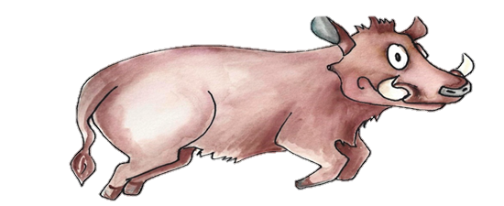
Next Session….. Comprehension and Retell Thank you for your participation See you at the next Learning Safari

